Slide 1
INVENTORY MANAGEMENT SYSTEM
Team: SAIGON
Thao, Doan
Scott Ritchie
SHERIDAN COLLEGE

Slide 2


Slide 3
INDEX
OVERVIEW
INTRODUCTION
DESIGN
Q & A
CONCLUSION
MODIFICATION

Slide 4
Purposes of this application
helps to keep their business running smoothly
Maximize profits
Reduce cost

Slide 5





Programs used

Slide 6
DESIGN
1 JavaFX Application class
6 FXML files
6 Controller classes
Product class
ProductList class
JOptionPane & Alert Box

Slide 7
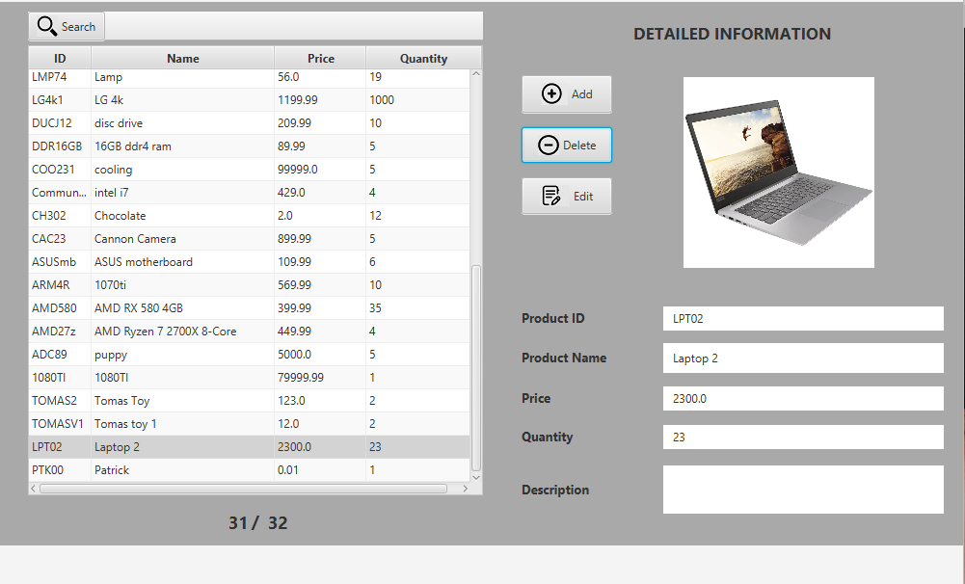
FUNCTIONALITIES
Search
Sort
Count total records
Add
Delete
Edit

Slide 8
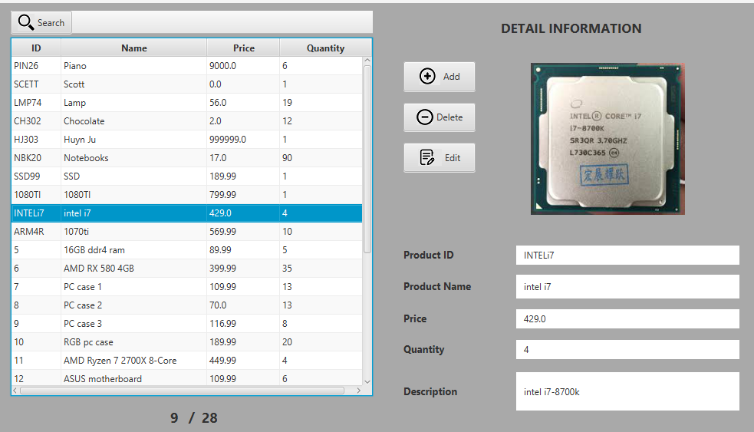
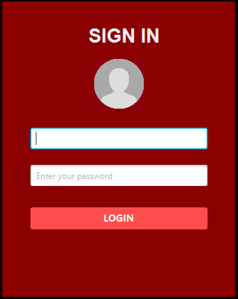
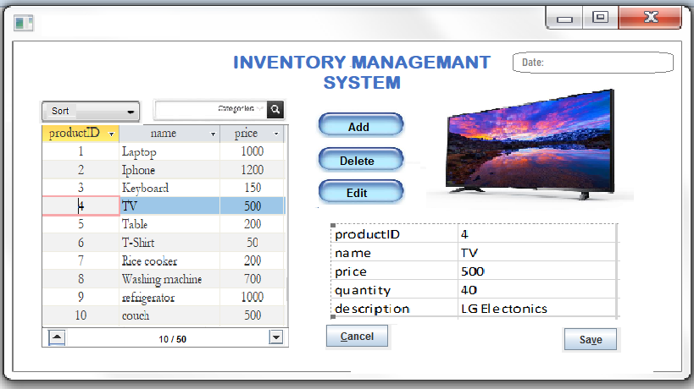
MODIFICATIONS

Slide 9
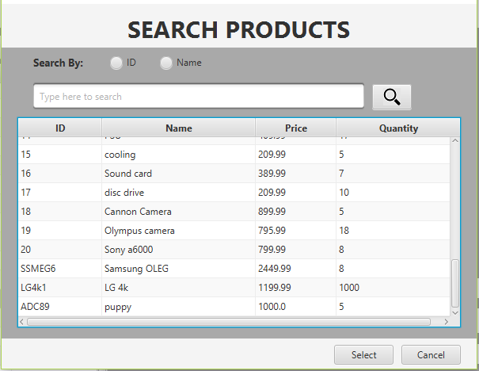
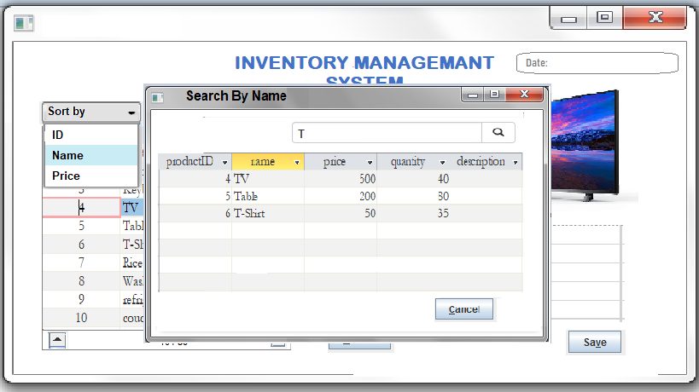
SEARCHING WINDOW
Search by

Slide 10


Slide 11


